Slide 1
Federal Work-Study & Student Employment Procedures
2026-2027

Slide 2
FWS & Student Employment Training Agenda
Overview of the FWS Program
Details of the Federal Work-Study procedures and Payroll Authorization Form (PAF)
How to Set-up/Change Federal Work-Study
Cost Distributions in Success Factors
Student Employee Procedures Handbook
Question and Answer Session

Slide 3

Federal Work-Study
A federally funded program that helps students with financial need get part-time jobs, allowing them to earn money to help pay for college expenses.
Education is first priority so students usually work 10-15 hours/week.
The program encourages community service and work related to a student’s course of study (when possible)
FWS jobs may be on or off-campus positions.
  Most jobs on campus and offered through Purdue are eligible for FWS,
  Off-campus positions are with public agencies or private non-profits.
75% FWS funds/25% employer funds split.
  100% FWS funds coverage is possible for students working an eligible tutor position (reading/math).

Slide 4

Federal Work-Study: Eligibility & Awarding
Eligibility for incoming students
Student must be ugrad and file a FAFSA.
Be enrolled at least-half-time in a degree-seeking program.
Have an SAI of </= 15,000
Have unmet need.
Eligibility for returning students
Must have earned FWS in prior year
Awarding
Max award for Academic Year (AY) is $3,000 ($1,500 for fall/spring only).
Amounts can be increased marginally if requested and unmet need exists—FWS funding must not be exhausted.
Students may continue to earn FWS funds during the following periods: October, Winter and Spring breaks
No summer FWS offered.

Slide 5

Federal Work-Study: Hours
Student Employee Hours and Pay Restrictions
Cannot be paid for non-work hours: vacation, holiday, sick...
Cannot work flex-time
Hours cannot accumulate over several pay periods
Cannot have pay garnished for any item other than amounts owed for attendance during an award period
Should not work over 40 hrs/week and must be paid for all hours worked at an hourly rate
  Undergrads cannot be paid via stipends
Students working in more than one dept. should not work more than 40 hrs/week combined
In case of overtime occurring, dept. will be asked to cover overtime costs (split if more than on dept.)

Slide 6

Federal Work-Study: Additional Information
Student Employee Additional Information
Must not displace current employee
Must be paid for all hours worked (cannot volunteer services/time)
May earn academic credit while working a FWS job when applicable

Slide 7
Federal Work-Study: Departmental Information
Division of Financial Aid
Bursar
Center for Career Opportunities
DFA is responsible for awarding FWS through the packaging process and adjusting awards as needed due to over awarding. We are also responsible for ensuring the process runs as it should and that regulations are being followed.
DFA works in conjunction with the Bursar to reconcile FWS throughout the year and at the end of each academic year.
The Bursar is responsible for setting up new FWS employers in the SAP system. They collect any necessary contracts and also Payroll Authorization Forms (PAF).
They make any necessary adjustments between departmental (employer) funds and FWS funds when an over award or other adjustment occurs.
They also reconcile throughout the year and at the end of the academic year.
CCO is responsible for finding off-campus employers that would be eligible to participate in the FWS program. They also help link students up with these job opportunities.

Slide 8
Federal Work-Study: Benefits
Benefits for Students
Earn money to use for living expenses—decreasing the need for them to rely on loans.
Appear more attractive to an employer since some of their wages will be covered by FWS funding.
Gain experience to add to their resume.
FWS earnings are not factored into FAFSA Student Aid Index (SAI) calculation.
Benefits for Employers
FWS student wages are generously subsidized by the FWS program—cheaper labor for them.
Get to select potential employees from a pool of candidates who have some college experience.

Slide 9
Federal Work-Study: Posting Positions & Payroll
On-Campus Employers
Off-Campus Employers
Payroll Setup
Post their positions through Success Factors. For assistance, they can email careers@purdue.edu.
Post their positions through Center for Career Opportunities (CCO). For assistance, they can email hire@purdue.edu.
The Bursar’s Office helps initiate, monitor, and maintain FWS earnings throughout the year. If an on-campus or off-campus employer needs help with FWS payroll setup, please have them email workstudy@purdue.edu.

Slide 10
Federal Work-Study: Work steps
Accept Award > | Search for Work > | Let Employer Know > | Start Earning
Student will accept their award offer on myPurdue. | Student will search/apply/interview for a FWS eligible position on or off-campus. | During the interview process, student will let employer know they were awarded FWS. Employers are also able to ask. On-campus employers also have access to a report that will disclose which students are FWS eligible. | The employer fills out the correct paperwork with the Bursar (workstudy@purdue.edu) and completes necessary onboarding. The student starts earning their hourly wage set by the employer. Student will get paid bi-weekly.
Path to report in Cognos
  Team Content
  Departmental Content
  PWL
  Treasurer
  Comptroller
  Federal Work-Study Report – Payroll and FA Data.
  Report View of Federal Work Study – Award & Employment Details

Slide 11
Federal Work-Study: Important Notes
Important Notes
Employers dictate the hourly wage of FWS students they hire—this is not determined by FWS.
FWS supplements the hourly wage the employer sets (either 75%/25% or 100%--depending on the position).
The FWS award amount only dictates how much the student can earn while benefitting from the FWS supplement. Once exhausted, the employer will then be responsible for 100% of the employee’s hourly wage.
There are some jobs/departments that can only employ students for as long as the FWS funds help supplement the hourly wage—due to that department’s budgetary constraints—but this would be something an employer should let the student know upon hiring.

Slide 12
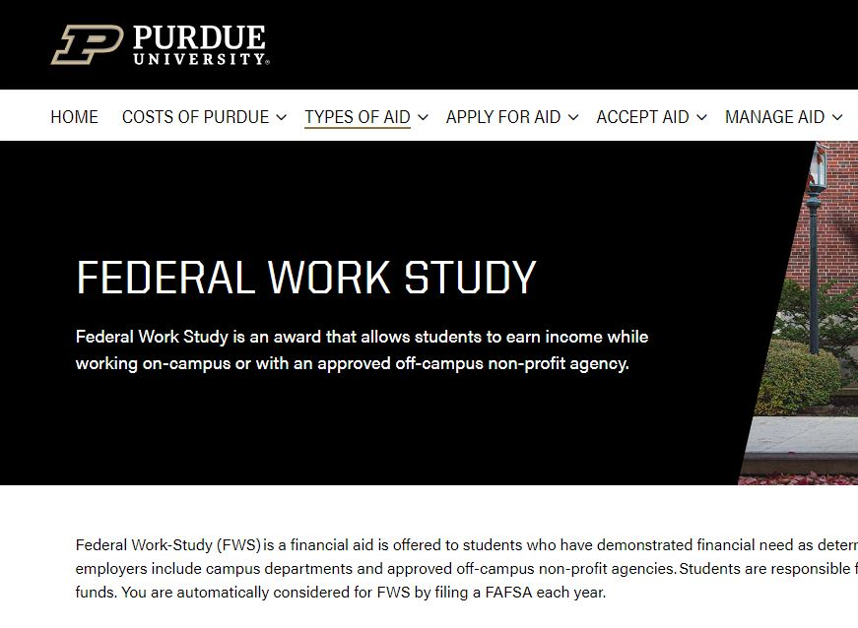
Federal Work-Study: Website
Students and employers can refer to our FWS page on the Division of Financial Aid website for more information: www.purdue.edu/dfa/aid/workstudy

Slide 13
Off-Campus Partner Tasks
Complete Current Year FWS Contract >
Post Job(s)>
Verify Candidates’ Eligibility>
Email workstudy@purdue.edu to obtain a contract.
At this time, your organization’s eligibility to participate in the program will be determined.
Complete contract and email back to workstudy@purdue.edu.
Payroll Authorization Form (PAF) and payroll schedule provided upon receipt of contract.
Job boards in the process of being updated with our new system, Purdue Career Gateway.
Select candidates you feel would be a good fit for your organization.
Email workstudy@purdue.edu to verify candidates’ FWS eligibility.

Slide 14
Off-Campus Partner Tasks Cont’d
Interview & Offer>
Complete PAF>
Approve Timesheets
Interview eligible candidates
Offer job to candidate
If the candidate accepts the job, fill out a Payroll Authorization Form (PAF).
Submit completed form to workstudy@purdue.edu. This kick-starts the hiring process.
Once the candidate has completed the hiring process, you will be notified that they can begin work.
Students will enter their time via a timesheet in Success Factors, paid bi-weekly.
Partners must provide students’ hours worked by 8 AM every other Monday morning (due date of each pay period provided via the payroll calendar).

Slide 15
Federal Work-Study: Billing
Billing
Billing Example (75/25 Split):
Off-Campus partners will be billed for their portion of their students’ earnings plus any overages, should they occur, at the end of the academic year (typically in June).
Award amounts are restricted to the term they were awarded. For example, if a student doesn’t use their full fall award, the excess does not carry forward to the spring.
Overages are limited. If a student goes over their award in the middle of a pay period, we will go ahead and pay out that entire pay period, including the overage. If the partner wants to continue to work the student after that, the student would need to flip to the partner’s payroll, the off-campus partner would pay them directly.
Fall Award: $1,500
Spring Award: $1,500
Fall Earnings: $1,500
Spring Earnings: $2,000
Award Pays: ($1,500 x 0.75)+($1,500 x 0.75)= $2,250
Partner Pays: ($1,500 x 0.25)+($1,500 x 0.25)+$500= $1,250

Slide 16
On-Campus Employer Tasks
Verify Eligibility
Complete Payroll Authorization Form (PAF)
Enter FWS Cost Distribution
Go to Cognos and follow path: Team Content > Departmental Content > PWL > Treasurer > Comptroller > Federal Work Study Report - Payroll and FA Data > File: Report view of Federal Work Study - Award & Employment Details
Access to this report is limited to approved personnel. Work with your Business Office/Payroll Team Lead to verify FWS eligibility.
The student’s award must be in accepted status to continue.
The FWS PAF template is housed here under On Campus Payroll Clerk-Business Office Information: https://www.purdue.edu/dfa/aid/workstudy/
Complete the PAF, including the job description.
Save the completed PAF and email to workstudy@pudue.edu once student is fully set-up.
If a student is actively working more than one job, a PAF must be completed for each position (perner).
Payroll clerk sets up CD using T-Code “PA30” in Success Factors
Ensure that the correct start and end dates are used:
Start Date: Student’s start date or the start date of the eligibility period, whichever is later.
End Date: End date of the eligibility period.
Ensure the correct FWS IO and split is utilized.
Unless otherwise communicated, for on-campus jobs, it will always be 75/25 split on the regular FWS IO (7400000751).

Slide 17
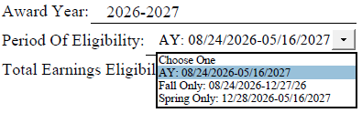
2026-2027 FWS Eligibility Dates
Academic Year: August 24, 2026 – May 16, 2027
Fall Only: August 24, 2026 – December 27, 2026
Spring Only: December 28, 2026 – May 16, 2027
These dates can be found on the Payroll Authorization Form (PAF) template as well.

Slide 18
2026-2027 PWL Federal Work-Study IOs
For on-campus jobs, you will use the regular FWS IO unless directed otherwise
FWS Regular
FWS Community Service
FWS Math Tutor
FWS Reading Tutor
FWS Off-Campus
7400000751
75/25 split
7400000754
75/25 split
7400000753
If tutoring K-6, eligible for 100% coverage.
7400000752
If tutoring K-6, eligible for 100% coverage.
4200002591
Used for off-campus partners ONLY.

Slide 19
Federal Work-Study Cost Distribution Entry
Step 1
Step 2
Step 3
  Enter T-Code “PA30”
  Enter InfoType “27”
  Enter department funding source at 100% (IT27 will always be 100% on the department)
  Enter T-Code PA30
  Enter InfoType 14
  Click Create
  Enter wage type 3814
  Enter Start/End dates, percentage (75), and then click Maintain Cost Assignment
  Enter funding source (FWS IO)
  Save
  Enter T-Code PA30
  Enter InfoType 15
  Select Create
  Enter Date of Origin (this is the start date, date must fall within the award eligibility period)
  Enter wage type 3812
  Enter award amount minus $1
  Save
  Steps 1-7 should be completed per eligible term (Fall & Spring)

Slide 20


Submission Deadlines
Federal Work-Study (FWS) setup must be completed within six weeks of a student's start date.
Fall award deadline: No FWS submissions for students with fall awards will be accepted after December 15th.
Spring award deadline: No FWS submissions for students with spring awards will be accepted after April 15th.

Slide 21
Eligibility Changes
Potential Changes to a Student’s FWS Eligibility
Federal Work-Study awards may be increased, decreased, or canceled at any point during the academic year.
Any award changes and any required cost distribution updates will be communicated via TDX to the student's employment center. (Agriculture, Health & Human Sciences, and Veterinary Medicine business offices will receive notifications by email.)
Departments will not be notified when a student has exhausted their Federal Work-Study funding. If a department needs to monitor award balances, it is their responsibility to track them.
Once a student has used their full Federal Work-Study award (IT15), their cost distribution will automatically switch to the department's funding source designated on IT27.

Slide 22

Unused IT15 Balances
When a student does not fully utilize their IT15 balance, a remaining balance may carry forward and result in excess earnings being charged to Federal Work-Study in subsequent semesters.
We are developing a process to identify and clear these remaining IT15 balances from prior aid years for business offices.
Additional details and implementation guidance will be shared as the process is finalized.

Slide 23
Thank You
Questions? Contact workstudy@purdue.edu

